Slide 1
Village of Caledonia Park and Open Space Plan Update
Parks and Recreation Advisory Committee
February 11, 2025
#271901-2

Slide 2
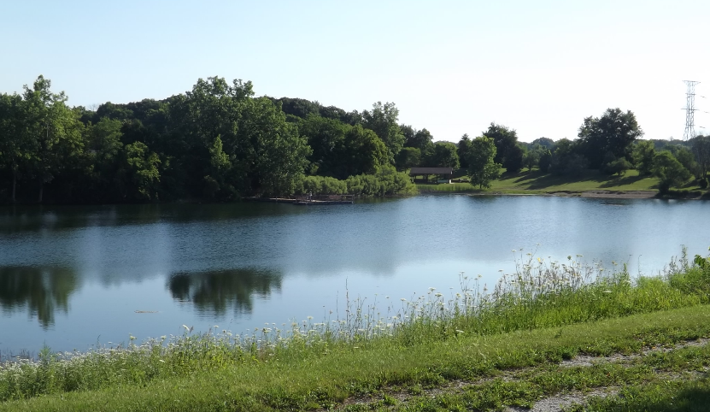
Park and Open Space Planning
Assess current and future needs
Park sites
Recreational facilities
Open space
Preserve, acquire, and develop land for parks, recreation, and open space
Provide a variety of recreational sites and facilities
Enhance natural resources
Fourth Edition of Village plan
Image Source: Southeastern Wisconsin Regional Planning Commission

Slide 3
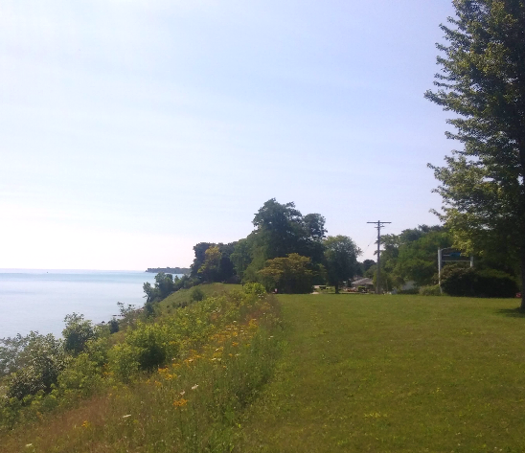
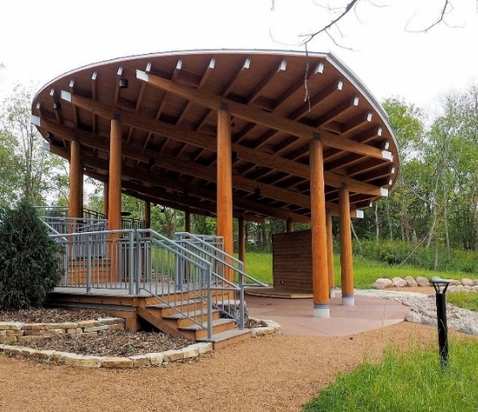
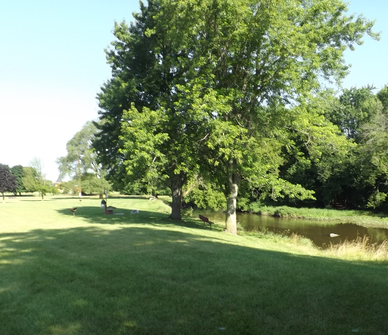
Planning Goals and Objectives
Policy document to set direction and create vision
Strategic guide for designing, developing, and managing a system of parks
Identify short range priorities and long term needs
Maintain eligibility for State and Federal grants
Design year of 2050
Image Sources: SEWRPC and Village of Caledonia

Slide 4
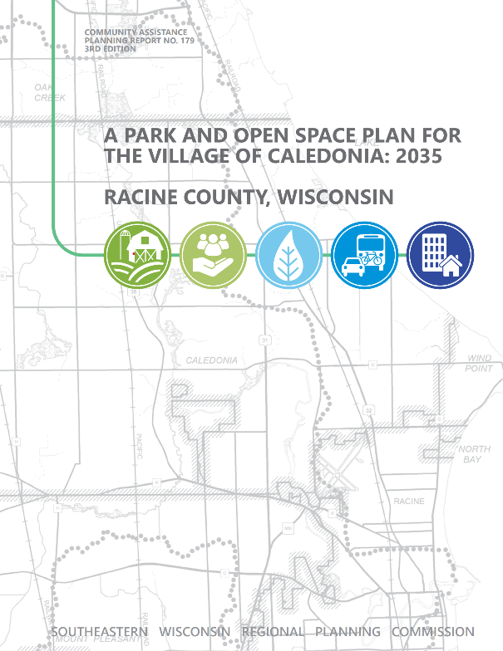
Plan Format
Five Chapters
Introduction
Inventory Findings
Status of Previous Plan Recommendations
Planning Framework
Park and Open Space Plan
Four Appendices
Regional Goals, Objectives, and Standards
Peer Community Benchmark Metrics
Root River Watershed Restoration Site-Specific Recommendations
Summary of Village Parks Survey Results
2050

Slide 5
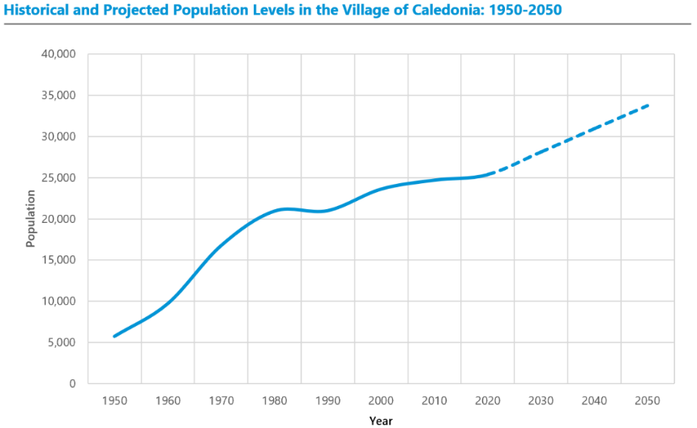
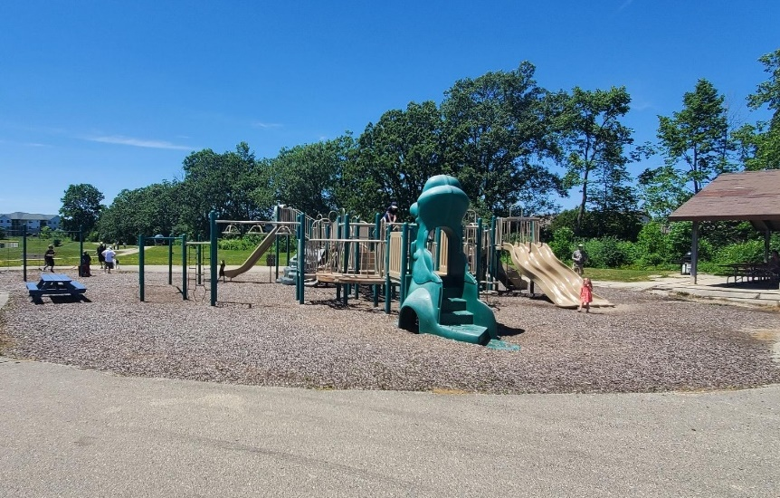
Key Inventory Findings
2050 population is projected to increase by nearly 33%
67 park and open space sites
Includes 27 publicly owned sites
40 privately owned sites
Four miles of public off-street trails
34 miles of on-street bike routes
13% of the Village in environmental corridors
14 natural areas and 14 critical species habitat sites
Image Source: Village of Caledonia

Slide 6
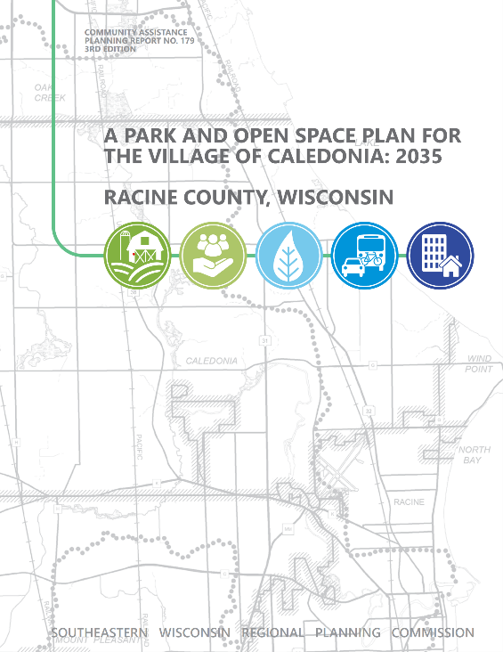
Chapter 3: Status of Previous Plan Recommendations
Completed or In Progress
Crawford Park expansion and upgrades
Improvements at Gorney, Linwood, and Maple Parks
Addition of Waters Edge Park
Remaining
Acquisition of most new park sites
Development at 5 ½ Mile, Chapla, and County Line Parks
Expansion and improvement at Nicholson Wildlife Refuge
Of-street trails and on-street bikeways

Slide 7
Chapter 4: Framework for Plan Development
Village, County, and Regional Plans
Needs Analysis – Hybrid Approach
Regional Standards
Biggest opportunities include basketball hoops and tennis/pickleball courts
Additional parks and facilities needed west of STH 32
Performance Benchmarks
Comparable to peer communities with exception of playgrounds
Does not measure quality or predict future needs

Slide 8
Village Parks Survey
534 unique responses
Highest priorities
More features and amenities
Better maintenance of facilities
Top activities
Walking or jogging
Enjoying nature
Playground (younger respondents)
85% - preserving natural areas important or very important
13% - bike/ped facilities high or very high quality
Playgrounds, splash pads, pickleball courts, trails, and beer gardens most desired amenities
Source: Village of Caledonia and SEWRPC

Slide 9
Chapter 5: Park and Open Space Plan
Areawide Recommendations
Racine County Parks
Maintain existing parks and facilities within Village
Develop master plan for Franksville Memorial Park
Bicycle and Pedestrian Facilities
Trail in Root River corridor
Maintain MRK Trail
Improve on-street facilities
Water Trails
Develop Root River Water Trail
Additional access on Lake Michigan State Trail

Slide 10
Village Recommendations: 2025-2030
Park recommendations based on survey, advisory committee input, and needs analysis
Projects included in five-year plan:
Preservation of natural areas and trails at 5 ½ Mile, County Line, and Waters Edge Parks
Trail, benches, and picnic tables at Chapla Park
Updated playground equipment at Linwood and Maple Parks
Improve soccer fields and restore prairie areas at Gorney Park
Repair and extend boardwalk at Nicholson Wildlife Refuge
Continue implementation Crawford Park Master Plan
Cost estimates to be prepared as part of CIP

Slide 11
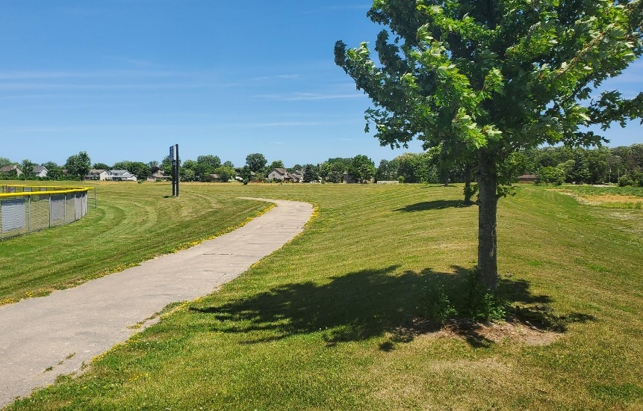
Long Range Recommendations
Trail and Bicycle Facilities
MRK Trail off-street between 6 Mile and 7 Mile Roads
Enhance on-street bicycle and pedestrian network
Water Trails
Develop Root River Trail
Enhance Lake Michigan Trail
Acquire 11 additional park sites in underserved areas
Preserve open spaces
Consider opportunities for recreational programming
Image Source: Village of Caledonia

Slide 12
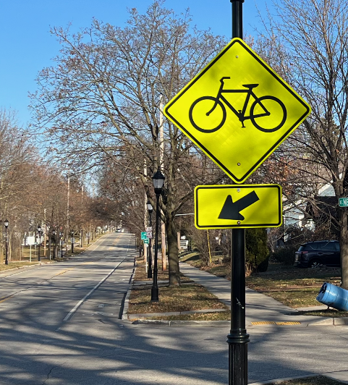
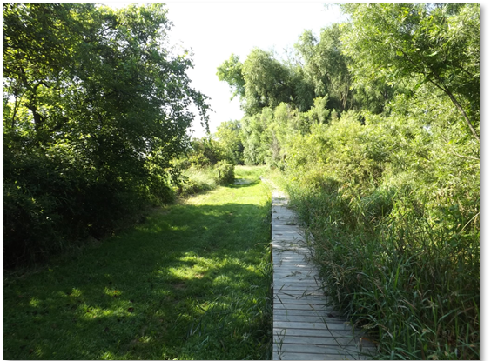
Next Steps
Recommendation of Village Parks and Recreation Advisory Committee
Tentative timeline
Public open house: February 19
Plan Commission and public hearing: February 24
Village Board adoption
Image Source: SEWRPC

